Slide 1
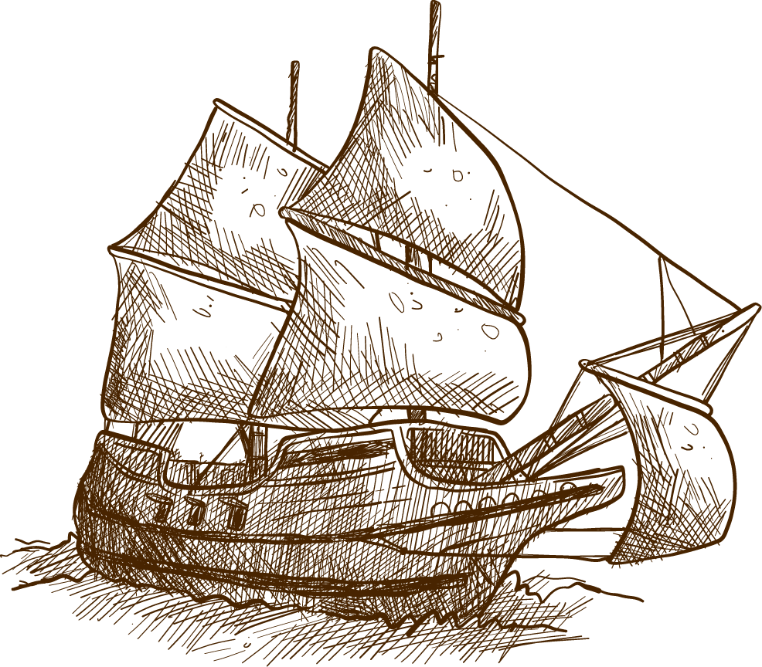
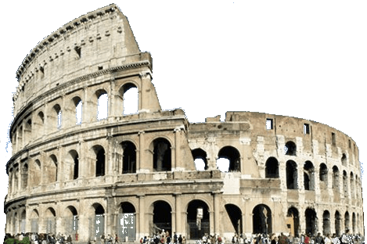
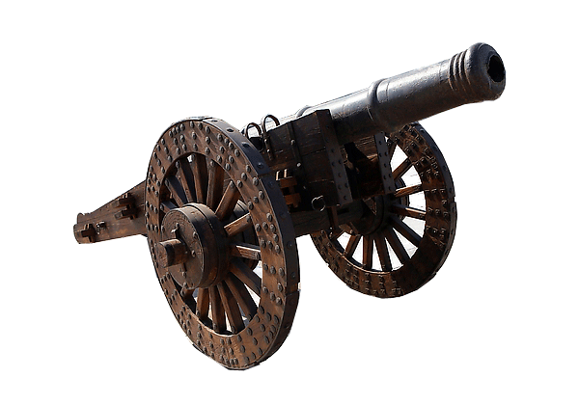
HISTORY
Enter the brave new world of
at GT12

Slide 2
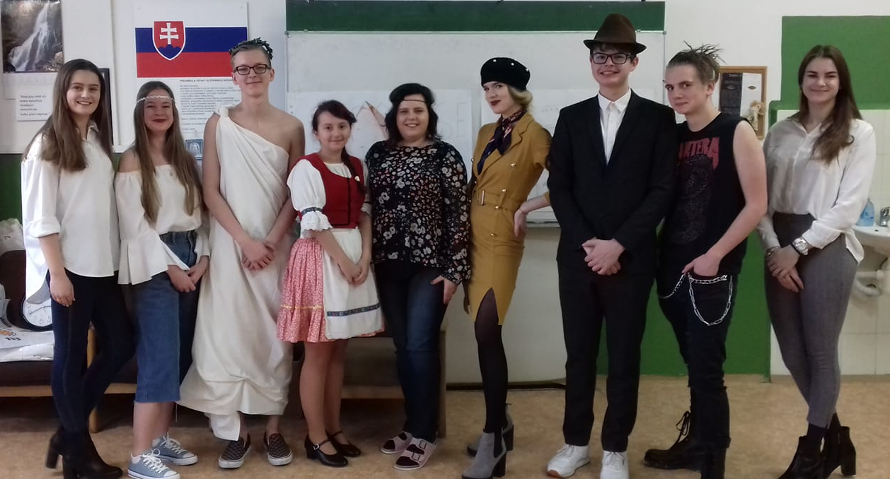
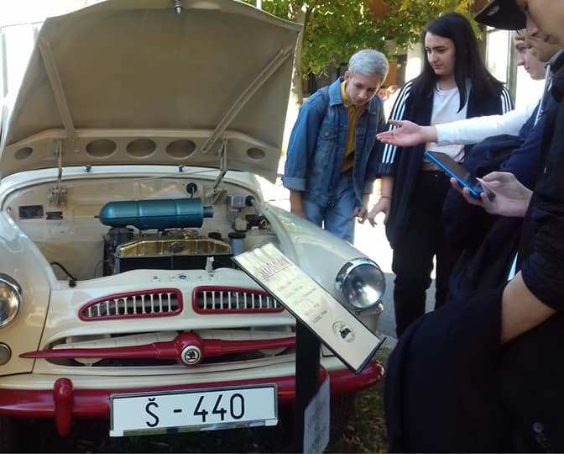
GT12 – a place where HISTORY is alive

Slide 3
History at GT12
Curriculum:
COMPULSORY - 2nd – 5th year of study (1-2 lessons a week)
World History – taught in English
Národné dejiny – vyučované v slovenskom jazyku
(preparation for maturita/state language exam) - OPTIONAL
Seminar in the 4th year – 2 lessons a week
Seminar in the 5th year – 5 lessons a week

Slide 4
TOPICS
Contemporary History:
The First World War
The Second World War
The Holocaust
USA vs USSR
Národné dejiny:
Slovania
Uhorský štát
Mária Terézia
Štúrovci
1. ČSR
Nežná revolúcia
Modern period:
The Age of Explorations
The Renaissance
Martin Luther
Liberte! Egalite! Fraternite!
Napoleon Bonaparte
Ancient History:
Egyptian mummies
Greek democracy
Roman gladiators
Jesus Christ
The Middle Ages:
Christianity
Islam
The Crusades
The Black Death

Slide 5
What our handouts look like

Slide 6
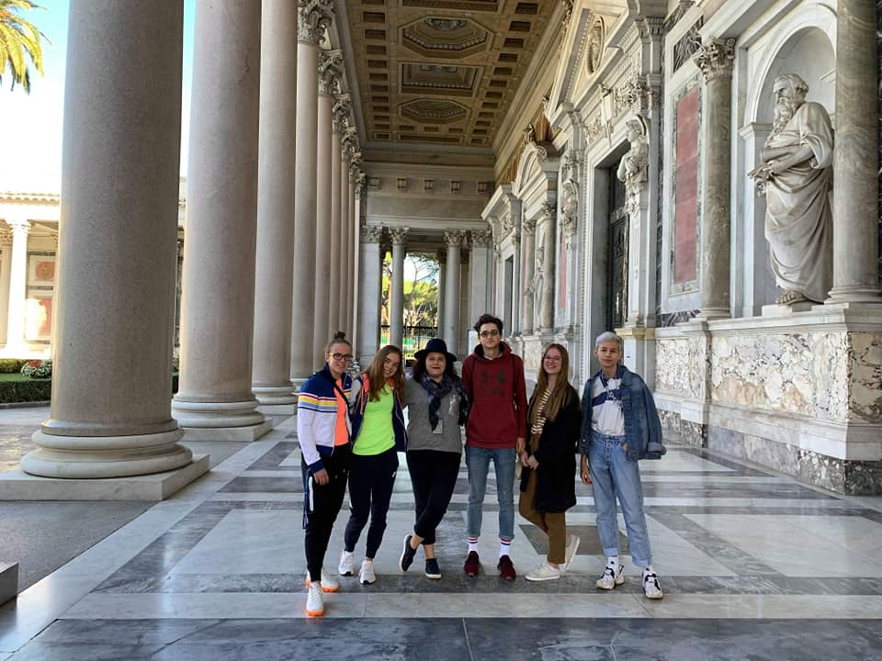
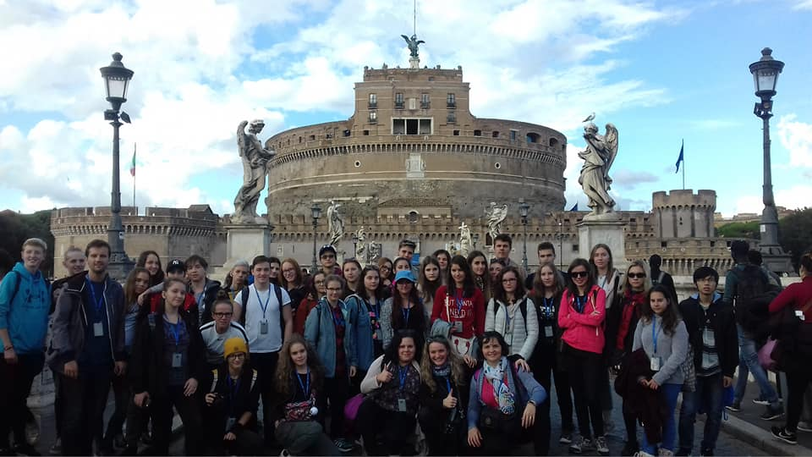
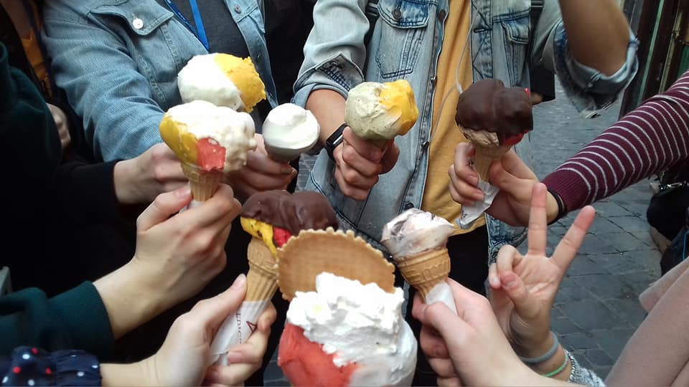
A visit is worth a thousand words
Excursion
Rome – Napoli - Pompeii

Slide 7
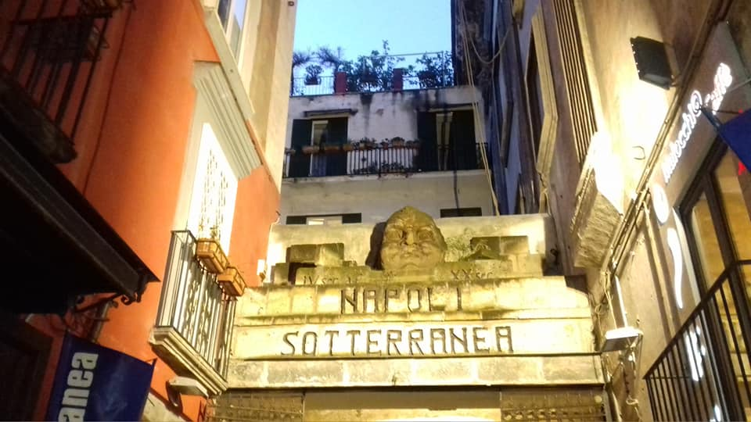
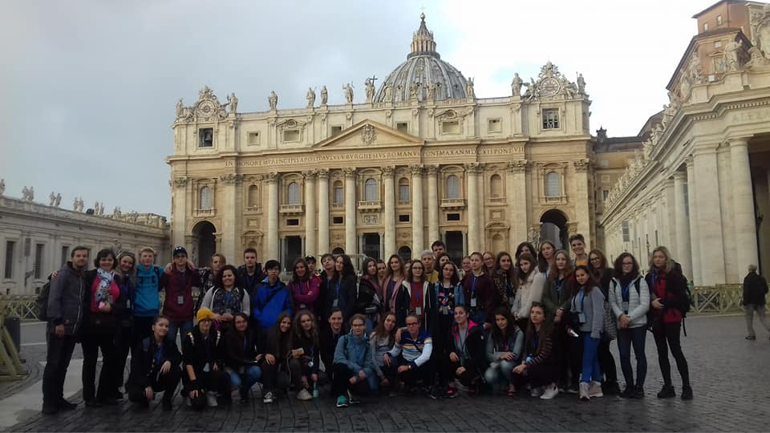
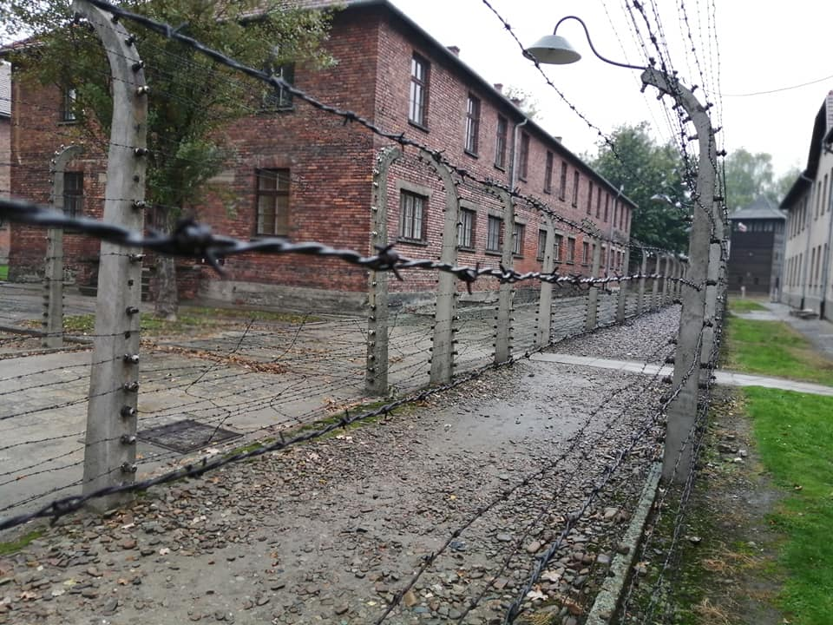
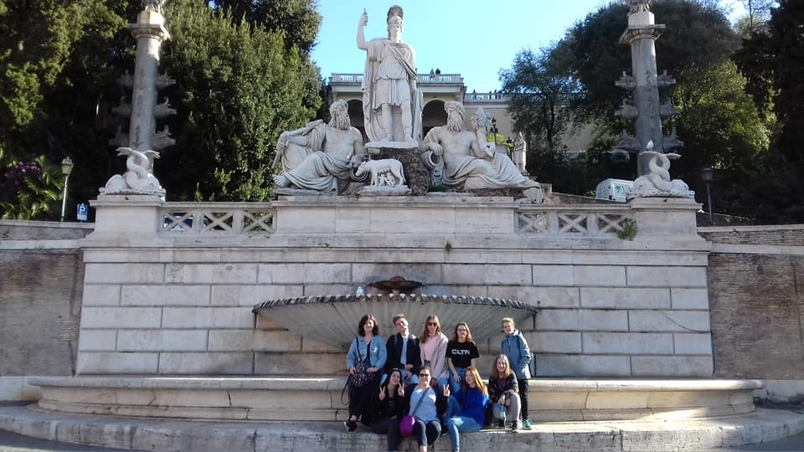

Slide 8
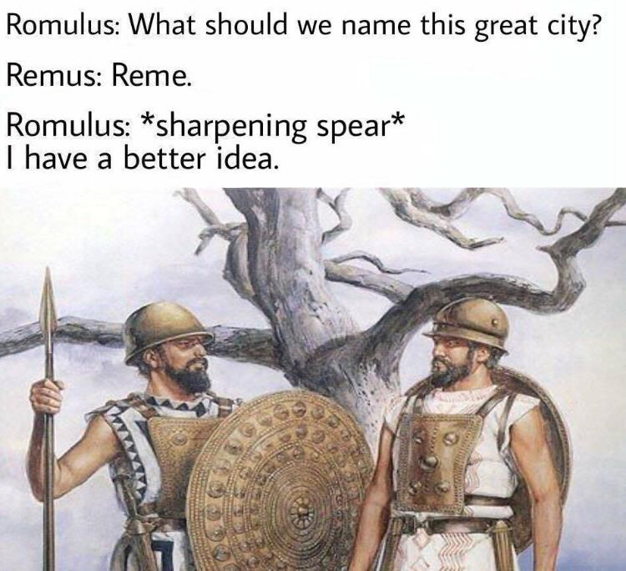
Didn´t get it? Do not worry! This is the best time to start learning history at GT12! ☺

Slide 9
